Slide 1

Student Performance
Colin Haley
August 2026

Slide 2
Agenda
1
Executive Summary
2
Data Description
3-5
Research Questions and Exploratory Analysis
6
Methodology
7-13
Results and Findings
14
Conclusion

Slide 3
Executive Summary
1
Objective
Significance
Recommendations
Determine whether demographics, family, and lifestyle factors before any grades exist can accurately predict whether students will pass or fail their math course. We want to identify the strongest predictors of failure risk using a variety of predictive models.
Math course failure is an early warning signal for dropout risk. If schools can identify at-risk students at the outset, targeted support could be provided before problems arise.
Our results show that predicting failure risk is more difficult than expected. Models built only on demographic and lifestyle data topped out at 68% accuracy and AUC values of 0.46 - 0.59, indicating accuracy levels around those of random guessing. We consistently missed the majority of students who actually failed, with recall as low as 8%.
These results are meaningful on their own, showing us that demographic and lifestyle factors alone are not enough to predict student success or failure.
Schools should not rely on demographic or lifestyle data alone to identify students at-risk for potential course failure. This data should be paired with grade data. Grades from previous semesters and years should be considered when predicting student success.
As we search for more accurate models, we should continue to use behavioral patterns such repeated past failures, low study time, high absences, and high social/alcohol activity as a guide for optional outreach to those that could be higher risk.

Slide 4
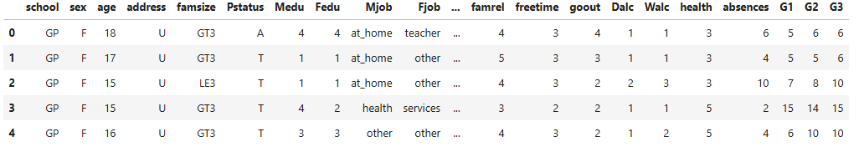
Data Description
2
Schoolsup (Categorical): Extra educational support (0=No, 1=Yes)
Famsup (Categorical): Family educational support (0=No, 1=Yes)
Paid (Categorical): Extra paid classes within the course subject (0=No, 1=Yes)
Activities (Categorical): extra-curricular activities (0=No, 1=Yes)
Nursery (Categorical): Attended nursery school (0=No, 1=Yes)
Higher (Categorical): Wants to take higher education (0=No, 1=Yes)
Internet (Categorical): Internet access at home (0=No, 1=Yes)
Romantic (Categorical): With a romantic relationship (0=No, 1=Yes)
Famrel (Numeric): Quality of family relationships (scale of 1-5)
Freetime (Numeric): Free time after school (scale of 1-5)
Goout (Numeric): Going out with friends (scale of 1-5)
Dalc (Numeric): Workday alcohol consumption (scale of 1-5)
Walc (Numeric): Weekend alcohol consumption (scale of 1-5)
Health (Numeric): Current health status (scale of 1-5)
Absences (Numeric): Number of school absences
G1 (Numeric): First period grade
G2 (Numeric): Second period grade
G3 (Numeric): Final grade (Target Variable) (G3 >= 10 is “pass”)
School (Categorical): Student’s school
Sex (Categorical): Sex of the student (0 = Female, 1= Male)
Age (Numeric): Age of the student
Address (Categorical): Rural or Urban address (0=Rural, 1=Urban)
Famsize (Categorical): Family size (0=LE3, 1=GT3), LE3 is family size less than or equal to 3, GT3 is a family size greater than 3
Pstatus (Categorical): Parent’s Cohabitation Status. T is living together, A is apart (0=T, 1=A)
Medu/Fedu (Numeric): Mother’s Education and Father’s Education (scale of 0-4, 0 is none, 1 is primary education, 2 is middle education, 3 is secondary education, 4 is higher education)
Mjob/Fjob (Categorical): Mother’s job and Father’s job
Guardian (Categorical): Student’s guardian
Reason (Categorical): Reason to choose this school
Traveltime (Numeric): Home to school travel time
Studytime (Numeric): Weekly study time (scale of 1-4, 1 is less than 15 minutes, 2 is 15 to 30 minutes, 3 is 30 minutes to an hour, 4 is greater than 1 hour)
Failures (Numeric): Number of past class failures
Source: UC Irvine ML
  Cortez and Silva (2008)
  Data Source Link
n: 395
k: 33

Slide 5

Business Objective and Research Questions
Predicting Final Grade
Significant Drivers
3
Using the information we have on a student at the start of the school year, how accurately can we predict whether or student will pass or fail in their final Math grade?
What are the specific factors that contribute most to a student’s risk of failing?
Importance and Potential Outcomes: How might a school use these risks to design intervention programs for at-risk students?

Slide 6
Exploratory Data Analysis
4
Data Cleaning
No missing values were found in the dataset.
No duplicate records were identified.
The dataset was ready for analysis without additional cleaning.
395 student records and 34 variables
Key Findings
Most students passed the course.
Most students reported moderate study time.
Most students had relatively few absences.
G1 and G2 showed the strongest relationship with final grade (G3).

Slide 7
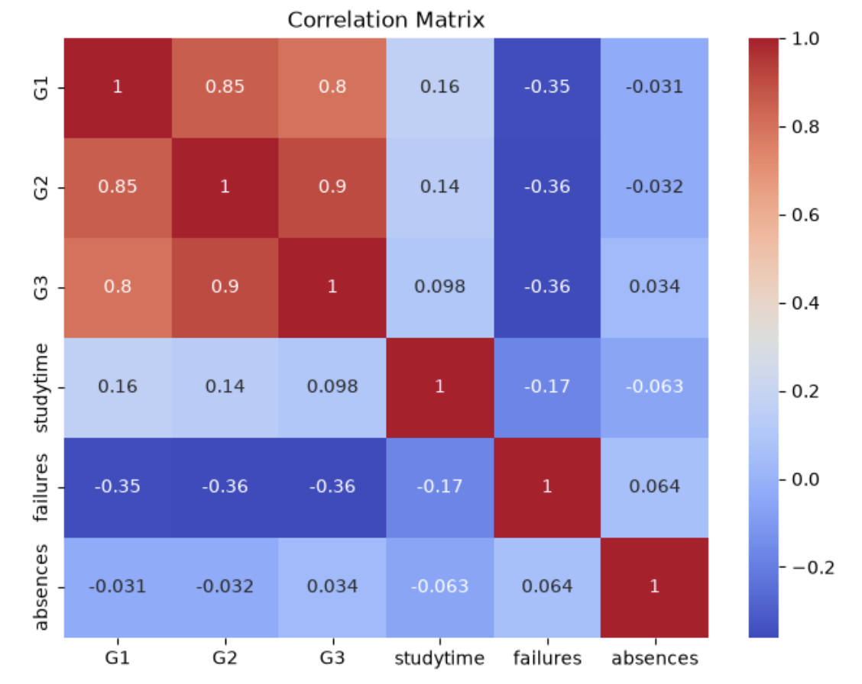
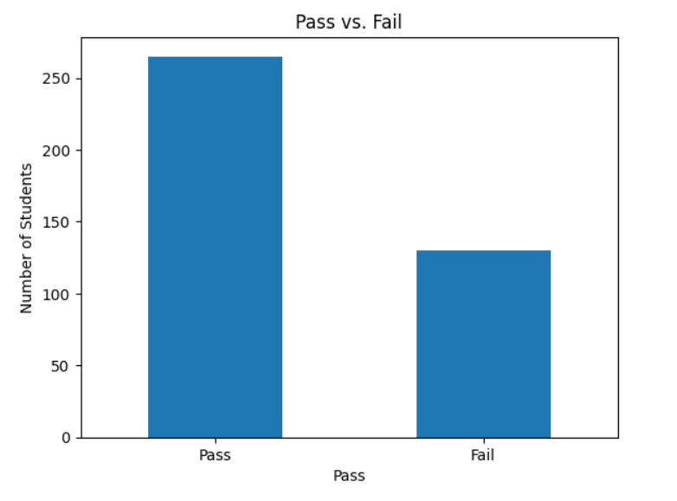
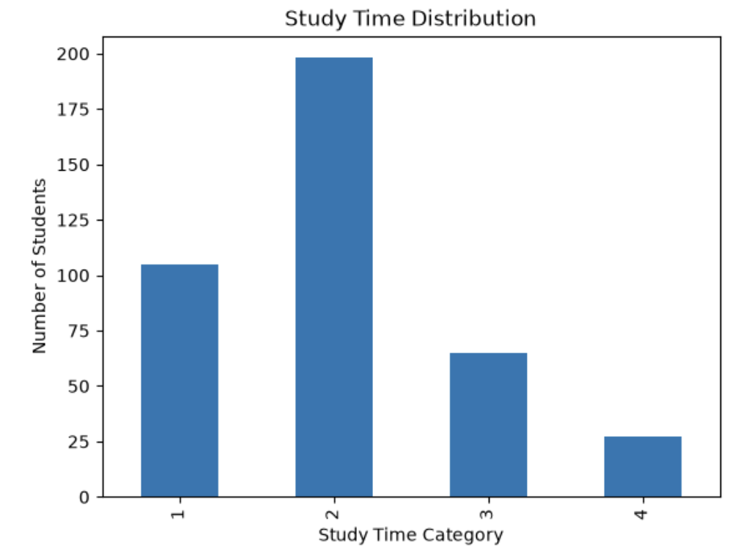
Charts
5

Slide 8
Methodology
Variables
Models
Modeling Methods
6
We had 30 demographic, family, school, and lifestyle predictor variables that were used to predict a binary pass/fail target.
First and second period grades and previous semester grades were excluded as predictors as we were interested solely in early prediction, rather than prediction after gathered data of repeated successes/failures.
We used four techniques including logistic regression, classification and regression trees, K-nearest neighbors, and clustering.
Within our classification trees, we used 5-fold cross validation. We used K-means in our clustering. Additionally, we used 5-fold cross validation and standardization in our K-nearest neighbors model.
All supervised learning models used an 80/20 stratified train/test split and were tested on accuracy of predictions with particular attention to the fail class, since we were attempting to create models to best identify at-risk students first.

Slide 9
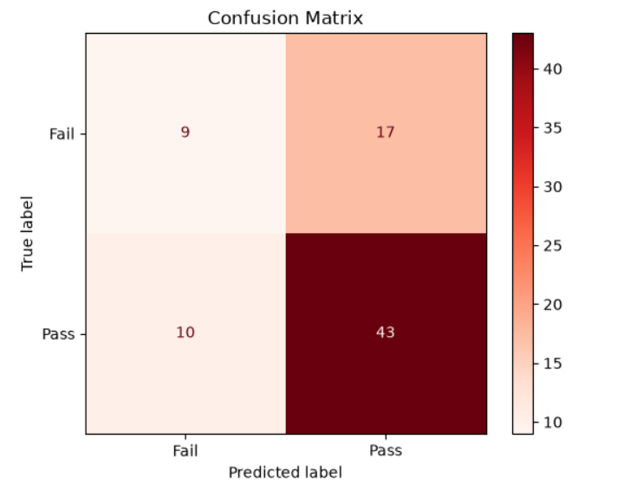
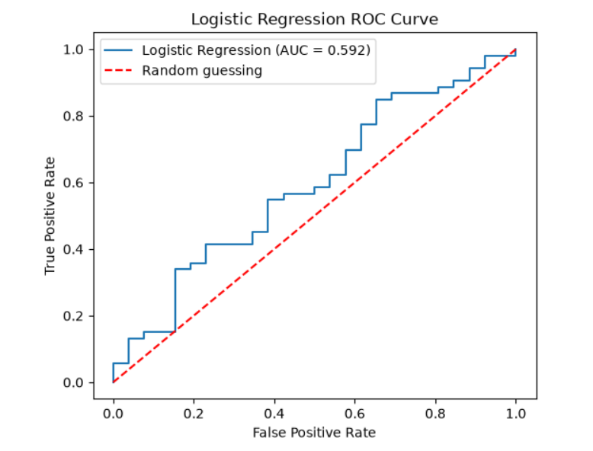
Results and Findings - Logistic Regression
Key Findings
7
Key Result: Demographic factors alone are not enough to accurately predict student performance
  An AUC value of 0.59 means that our model is barely better than than random guessing
Implication: Only 1 in 3 students were correctly identified that would fail the course, rendering our model ineffective at prevention
Bottom line: Based on logistic regression alone, we would be better served if prior grades were used in testing.

Slide 10
Results and Findings - K Nearest Neighbors
Model Setup
Performance
Key Findings
8
Targeting Pass / Fail, where G3 >= 10 is passing
80/20 stratified train-test split with predictors standardized for distance calculations
Tuning: tested k = 1-20 using 5-fold cross validation
k = 15
Cross-Validation Accuracy: 68.7%
Test Accuracy: 68.4%
AUC: 45.8%
Fail Recall: 8%
KNN achieved reasonable accuracy, but did not perform well at identifying students who ultimately failed.
Correctly identified 52 of 53 students who passed
Correctly identified 2 of 26 who failed

Slide 11
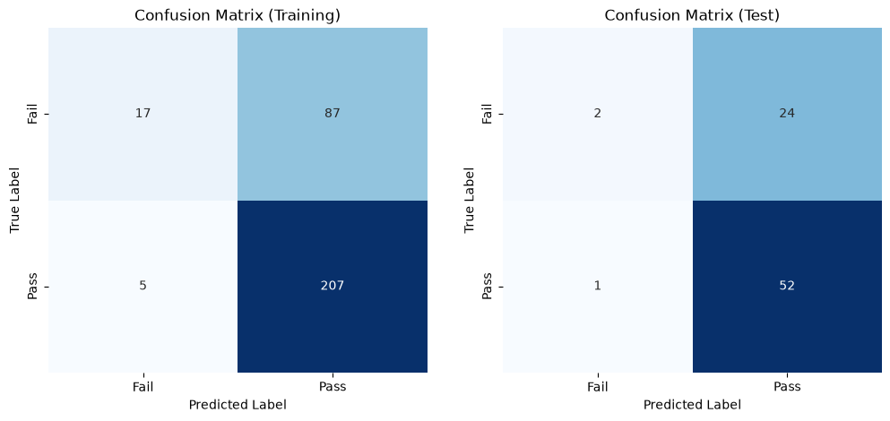
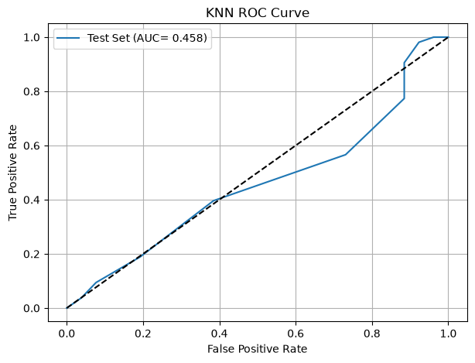
Results and Findings - K Nearest Neighbors
9

Slide 12
Results and Findings - Classification Tree
Model Setup
Performance
Key Findings
10
Model: Decision Tree Classifier
Same 80/20 train-test split
Target: Pass vs Fail
Baseline tree accuracy: 62.0%
Tuned tree accuracy: 67.1%
AUC: 0.588
Fail recall: 35%
Best depth: 1 via 5-fold CV
Main predictor: past failures
No previous failures -> predicted Pass
One or more failures -> predicted Fail

Slide 13
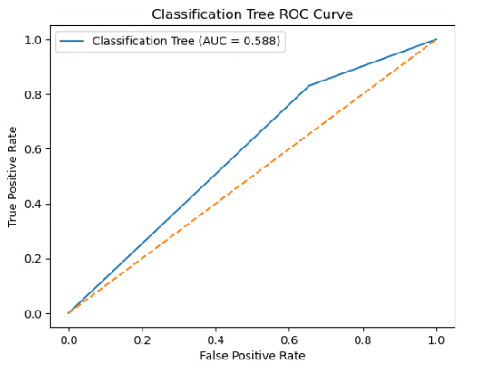
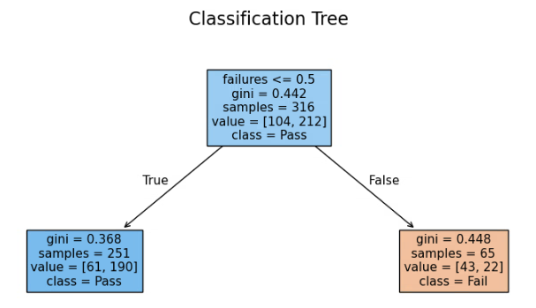
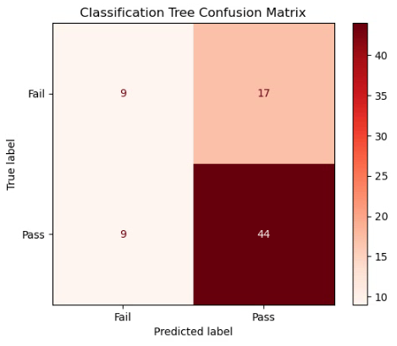
Classification Tree Visuals

Slide 14
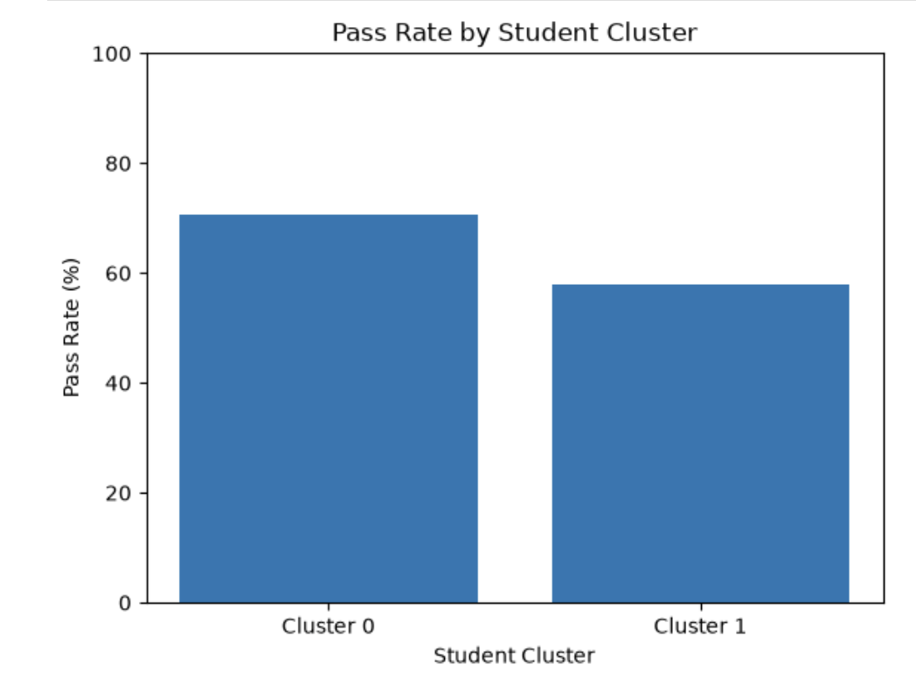
Results and Findings - Clustering
12
Cluster 0:
283 students
70.67% pass rate
Average final grade: 10.67
Studied more
Fewer absences and past failures
Cluster 1:
112 students
58.04% pass rate
Average final grade: 9.77
More absences and past failures
Higher social and alcohol activity
The results show that Cluster 0 had better academic performance, with more study time, fewer absences and failures, and a higher pass rate. Cluster 1 had more absences and failures, along with higher social and alcohol activity, and had lower academic performance overall.
Overall, the clustering suggests that study habits, attendance, past failures, and lifestyle behaviors may help identify students who are more at risk academically. The silhouette score of 0.299 shows some separation between the groups, but there is still overlap.

Slide 15
Model Comparison
Performance
Consistent Findings
Bottom Line
13
Logistic Regression: 65.8% test accuracy, AUC 0.59, 35% fail recall
Classification Tree: 67.1% test accuracy, AUC 0.59, 35% fail recall
K-Nearest Neighbors: 68.4% accuracy, AUC 0.46, 8% fail recall
Naive "predict all pass" baseline: 67.1% accuracy
No model meaningfully beats the naive "everyone passes" baseline, so this is one shared result, not three separate failures.
Every model misses most students who actually fail as KNN's high accuracy comes from predicting "pass" for nearly everyone.
Every method agrees: number of past failures is the strongest available predictor of risk.
None of these three models is reliable enough to drive real intervention decisions on its own, deploying one risks misallocating support or missing at-risk students entirely.
Treat this as a validated "not yet" rather than a dead end, as it tells us exactly what to add next.

Slide 16
Conclusion
Overall Summary
  All three classifiers landed on an average of 65% accuracy with an AUC range of 0.46-0.59, meaning all of our models were barely better than randomly guessing if a student would fail.
  Even though our clustering model was able to identify behavior factors that may put students are lower risk, our combination of all models were not able to accurately predict whether or not a student would fail based solely on demographic/lifestyle data.
Business Recommendation
  We should treat demographic and lifestyle data as supplemental and not a substitute for historical academic data.
Model Limitations
  A class imbalance of 265 passing students (Final Grade >= 10) vs 130 failing students biased our model towards passing students.
  Our predictive abilities were limited by our choice to exclude prior academic performance, and our linear/shallow-tree models likely miss real interactions between risk factors.
Future Research Focus Areas
  We should add previous academic performance to our demographic and lifestyle data.
  Aim to address class imbalance so our future models are not biased towards passing or failing.
  Test ensemble methods and a multi-tier risk framing (low/medium/high) instead of a binary cutoff.

